Slide 1
Capstone Sport Analysis Project Report

Slide 2
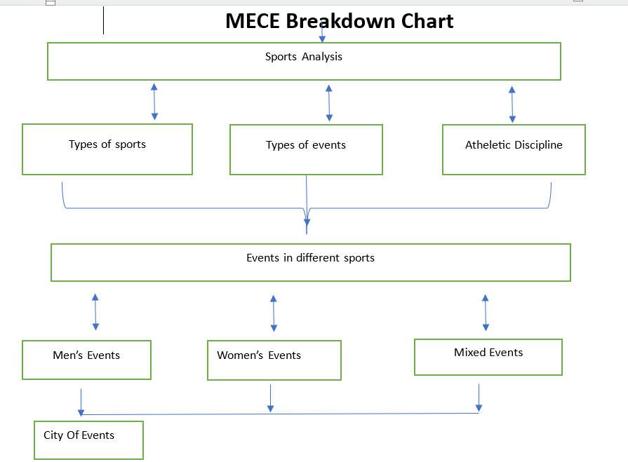
MECE Break Down

Slide 3
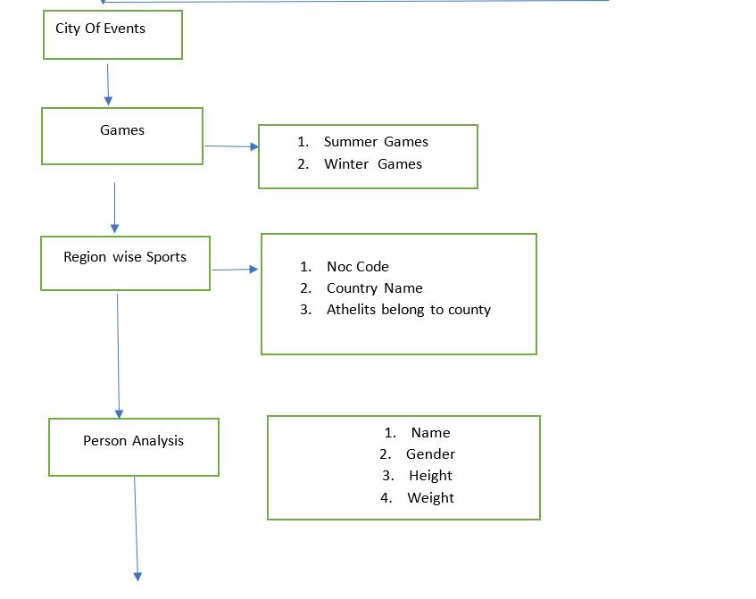

Slide 4
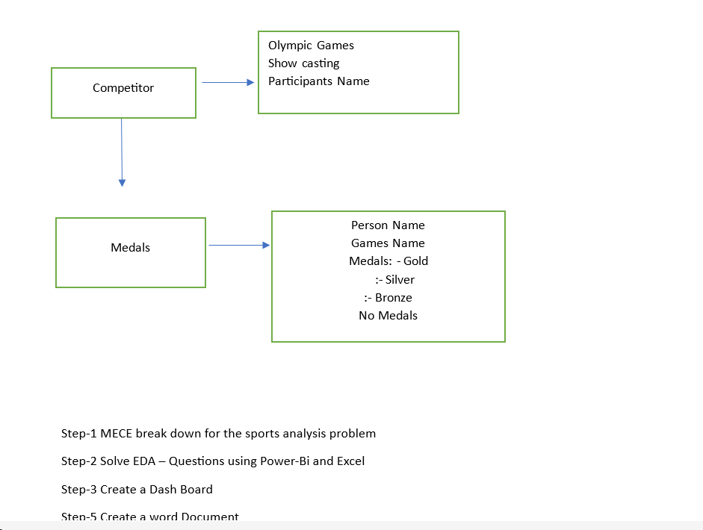

Slide 5


Slide 6
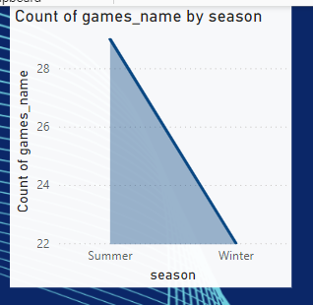
.1How many Olympic Games have been held in each season (Summer vs. Winter)?

Slide 7
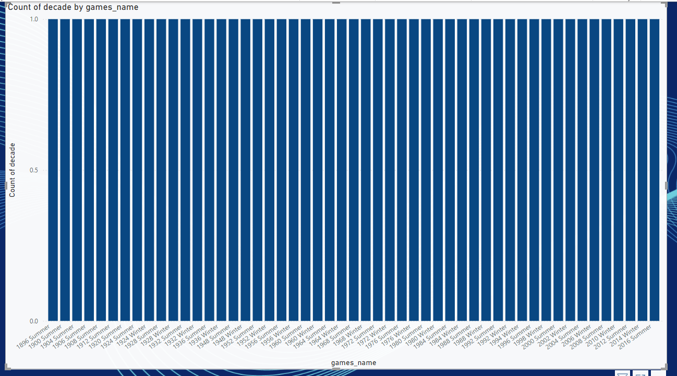
Q.2 What is the distribution of games across different decades?

Slide 8
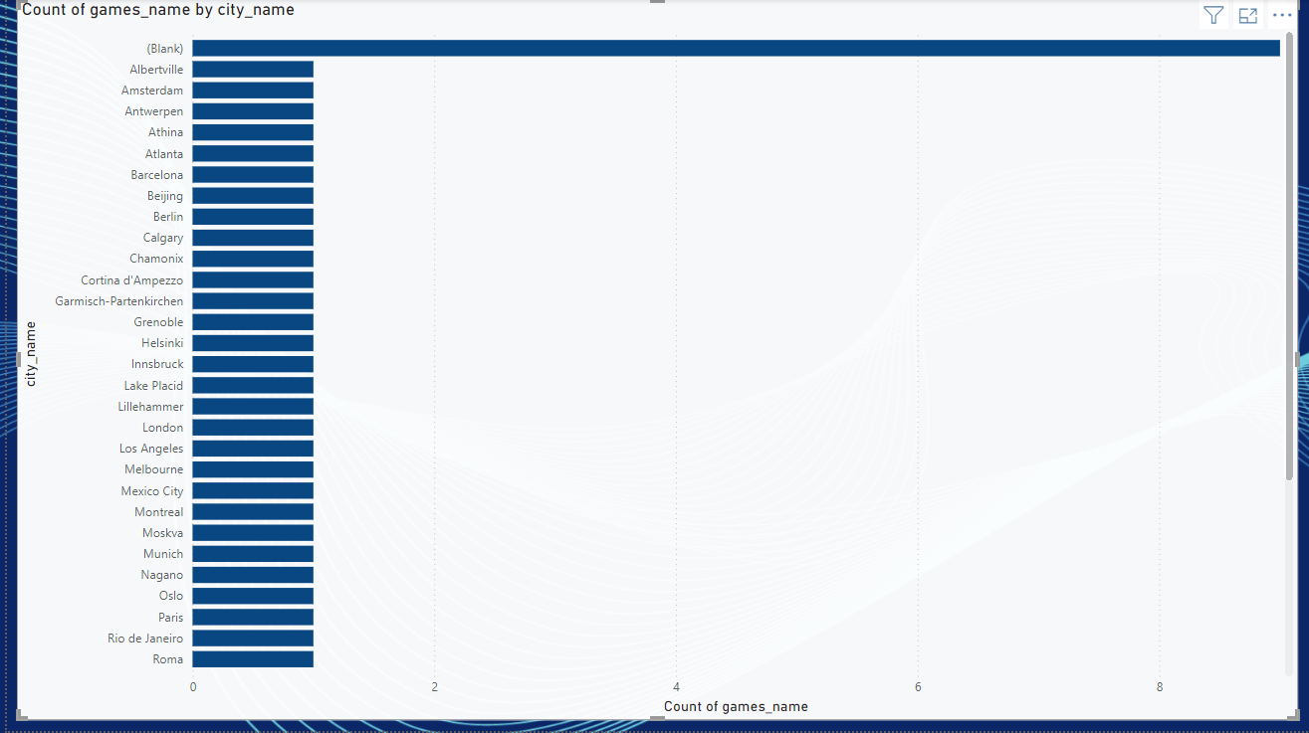
Q.3 Which cities have hosted the most Olympic Games?

Slide 9
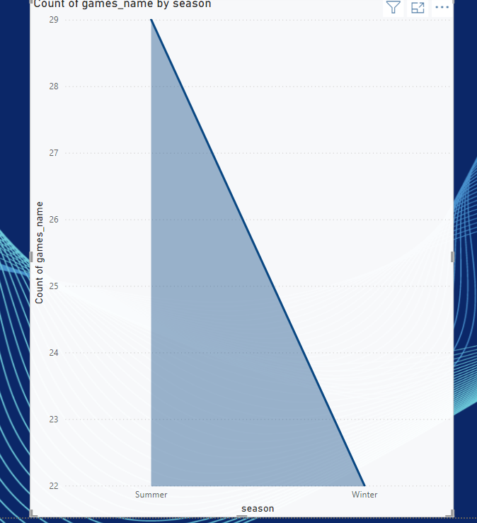
Q.4 What is the distribution of sports between Summer and Winter Olympics?

Slide 10
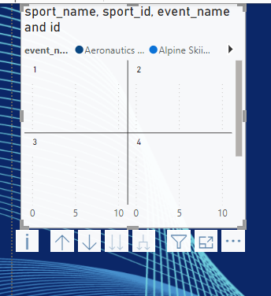
Q.5 Which sports have the highest number of events in the Olympics?

Slide 11
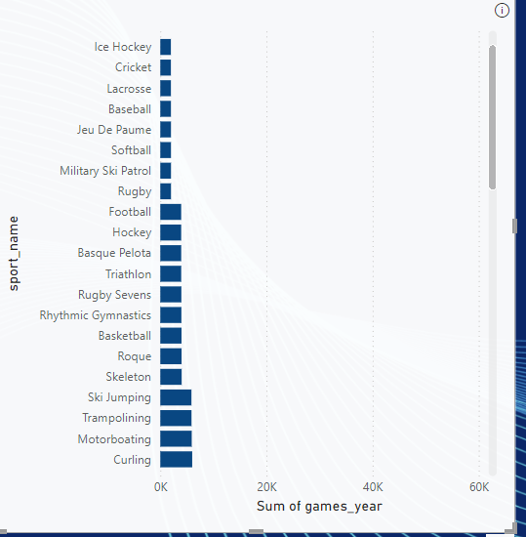
Q.6 How has the participation in each sport evolved over time?

